Slide 1


The Human Side of Digital Lending
Our Vision, Mission, and Values

Slide 2
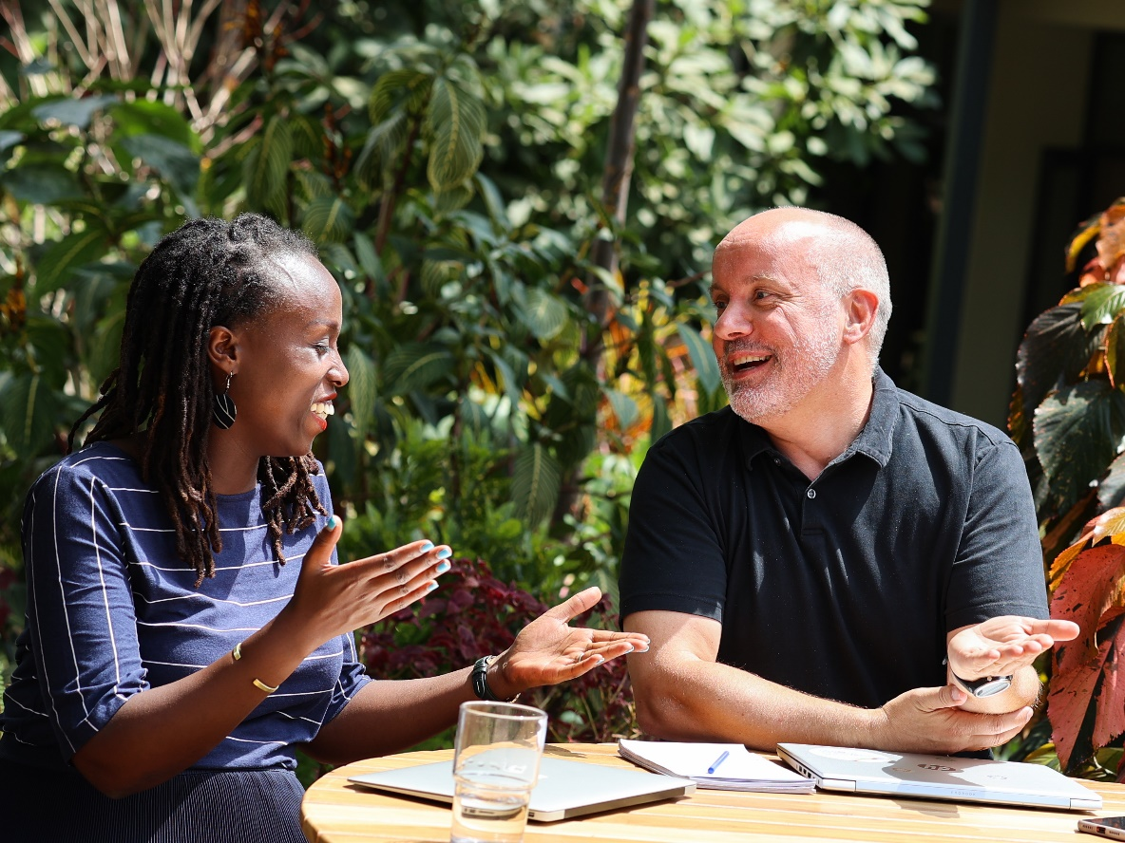
Our Vision and Mission
Vision: To be the most knowledgeable SME lending service provider and a long-term digitization partner to our clients.
Mission: Our mission is to strengthen financial institutions (in developing countries) to provide better and more impactful financial services to SMEs. We achieve this through focus on knowledge-based lending while emphasizing the human aspects of digitization.

Slide 3

Our Values
At Q-Lana we are open-minded and humble to the cause of delivering the most knowledgeable platform for SME Lending and serving our clients by digitizing the SME lending sphere.
Our results are delivered through a focus on the cause and pragmatism in the execution.
We honor our diversity that fuels innovation and connects us to the communities we serve. Sharing knowledge and experience across the team is in our DNA because our goal is to grow as individuals and strengthen every day, as a team.
As a team, we treat each other with respect and honesty. We admit our imperfections and strive to improve every day. This is equally expected by all our stakeholders.

Slide 4
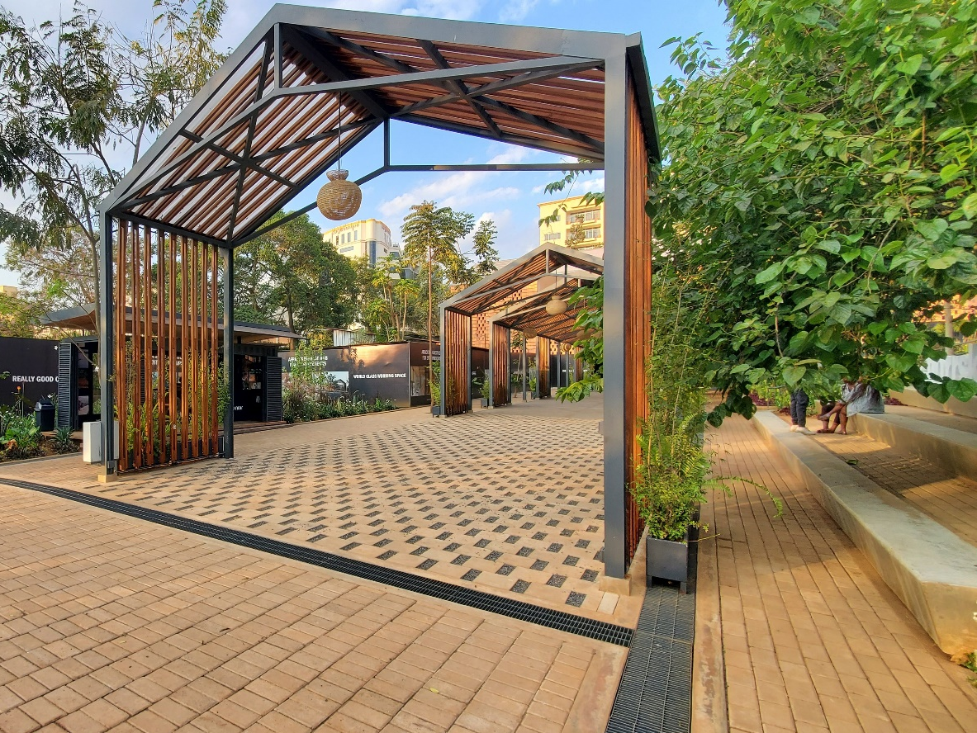

Contact
Christian Ruehmer
CEO
christian@q-lana.com
+1 917 498 5028
Karen Hazan
COO
karen.h@q-lana.com
+33 7 60 78 58 24
www.q-lana.com
info@q-lana.com

